Slide 1

INTRODUCTION TO TI CANADA
INSERT CHAPTER LOGO
OUR WORK, MISSION AND GOALS
Clair Woodside, Director, Transparency International Canada

Slide 2
WHO ARE WE?
Transparency International Canada is Canada’s leading anti-corruption organization
We are the Canadian chapter of the global Transparency International (TI) movement which has chapters working in more than 100 countries and an unparalleled global understanding and expertise of the challenges
Corruption = abuse of entrusted power for private gain

Slide 3
Vision, mission, core values
TI’s vision is a world in which government, politics, business, civil society and the daily lives of people are free of corruption.
Our mission is to stop corruption and promote transparency, accountability and integrity at all levels and across all sectors of society.
Our core values are transparency, accountability, integrity, solidarity, courage, justice and democracy.

Slide 4

Transparency
Transparency is about shedding light on rules, plans, processes and actions.
It is knowing why, how, what, and how much.
Transparency ensures that public officials, civil servants, managers, board members and businesspeople act visibly and understandably, and report on their activities.
Transparency means that the general public can hold them to account.
It is the surest way of guarding against corruption, and helps increase trust in the people and institutions on which our futures depend.

Slide 5


What do we do?
  Promote change that improves the lives of people by stopping corruption
  Research, educate and pursue evidence-based advocacy: identify the problem and what works to solve it
  Engage in critical but constructive engagement with all stakeholders
  Build alliances, draw on the strength of the TI movement, identify priorities and set strategy to achieve them

Slide 6
Our priorities
Combat corruption of all kinds in Canada
Reduce the role of Canadian companies and individuals in fuelling corruption overseas
Educate Canadians about the many faces of corruption and the harm that it causes
Advocate for tighter anti-corruption legislation and better whistleblower protection

Slide 7
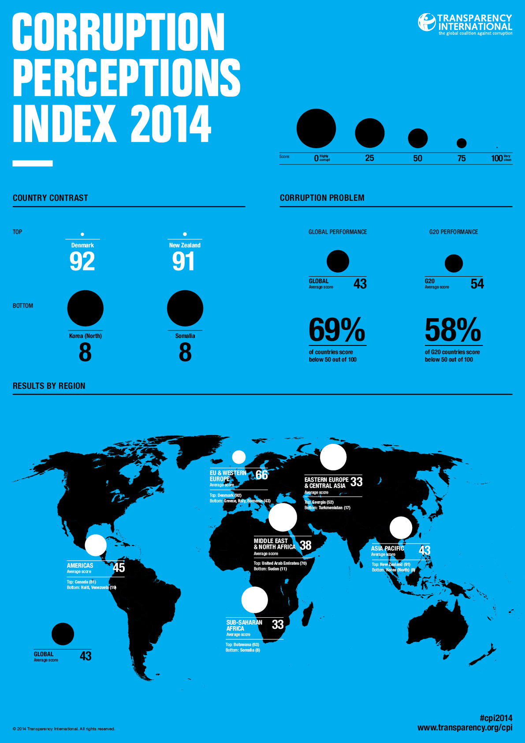
Ti’s signature tools/PUBLICATIONS
  Corruption Perceptions Index
  Global Corruption Barometer
  Global Corruption Report
  Anti-Corruption Compliance Checklist / Business Integrity Toolkit
  Bribe Payers Index
  Exporting Corruption Report

Slide 8
Join us!
Become a Member
Become a Supporter
Volunteer
DONATE

Slide 9



www.transparency.ca
@TI_Canada
/company/transparency-intl-canada
/TransparencyInternationalCanada
© 2015 Transparency International Canada Inc. All rights reserved.

