Slide 1


Manager Introduction
Welcome
GrandStay Hospitality, LLC
Quarterly Webinar Series
July 18, 2012

Slide 2

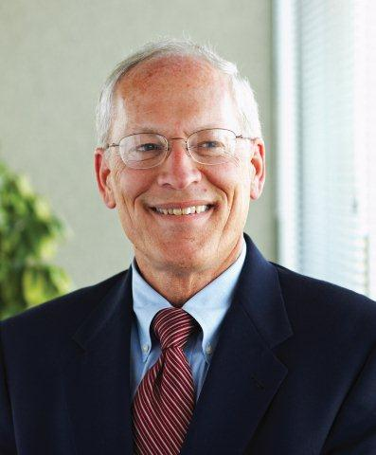
WELCOME
Jon Kennedy
President
GrandStay Hospitality, LLC

Slide 3
GrandStay Hospitality, LLC
The next GrandStay Hospitality
Quarterly Webinar
will be held
Wednesday, October 10, 2012

Slide 4
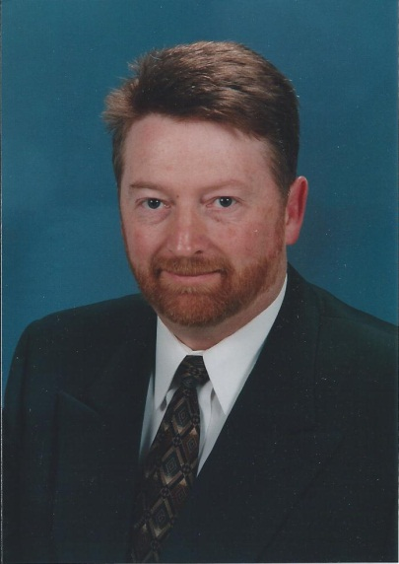
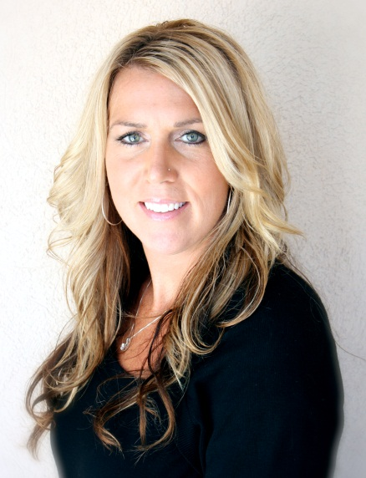
INTRODUCTION
John Synstegaard
President
Ovation Hospitality Group, LLC
Rachel Stack
Director of Franchise Services
GrandStay Hospitality, LLC

Slide 5
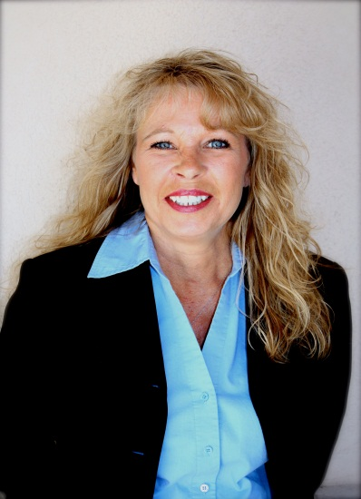
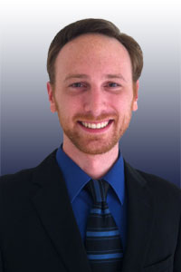
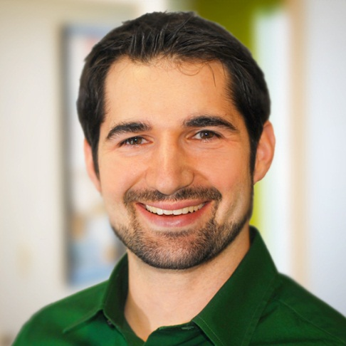
INTRODUCTION
Wendy Roe
Director of Sales & Marketing
GrandStay Hospitality, LLC
Peter Newhall
Head of Accounts
Adapta Interactive, Inc.
Mike Edens
Director of GID
EdensWorks, Inc.

Slide 6
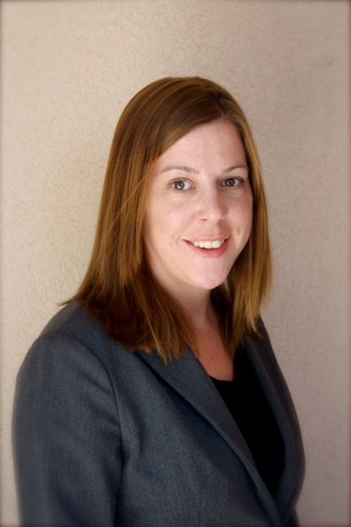
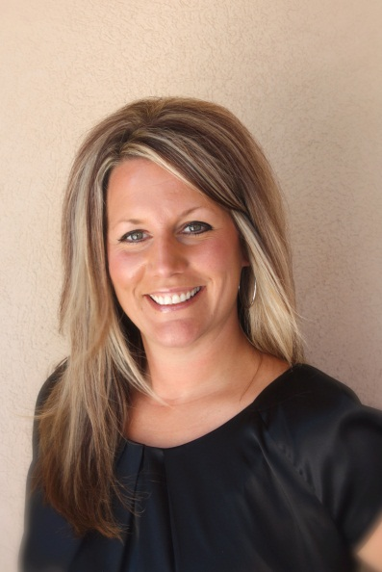
INTRODUCTION
Beth Ramacher
Accounting Director
GrandStay Hospitality, LLC
Robin Opatz
Executive Assistant
GrandStay Hospitality, LLC

Slide 7
QUESTIONS?
There will be a Q & A Session
at the end of the webinar.
Please hold all questions
until then.

Slide 8
Brand Standards & Operating Manuals
John Synstegaard
President
Ovation Hospitality Group, LLC
Rachel Stack
Director of Franchise Services
GrandStay Hospitality, LLC

Slide 9


Brand Standards & Operating Manuals
Introducing….

Slide 10
Brand Standards & Operating Manuals
Overview
Section 1: Operations
Section 2: FF&E Minimum Standards
Section 3: Construction Minimum Standards
Section 4: Technology Systems
Section 5: Sales & Marketing
Appendix

Slide 11

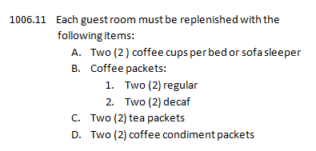
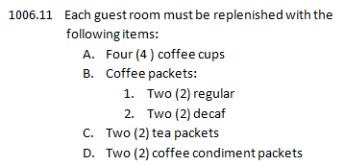
Brand Standards & Operating Manuals
Highlights….
Section 1: Operations
Crossings…
GrandStay…

Slide 12

Brand Standards & Operating Manuals
Highlights Continued….

Slide 13


Brand Standards & Operating Manuals
Highlights….
Section 2: FF&E Minimum Standards
This is a guide for the properties and design professionals for the following:
Renovations
Remodels
New Builds
Putting Green no longer required

Slide 14



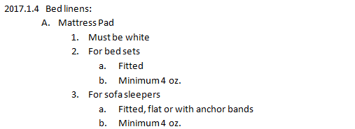
Brand Standards & Operating Manuals
Highlights Continued….
Section 2: FF&E Minimum Standards

Slide 15

Brand Standards & Operating Manuals
Highlights Continued….
Section 2: FF&E Minimum Standards
2017.1.10 Lamps
Lamp is to have two (2) electrical outlets in base
Rocker base switch
Lamps shall be rust proof mottled metal, ceramic or wood/
metal combination, no brass finish allowed

Slide 16
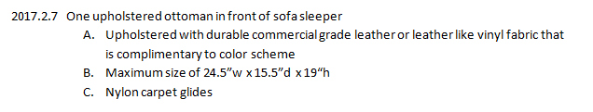
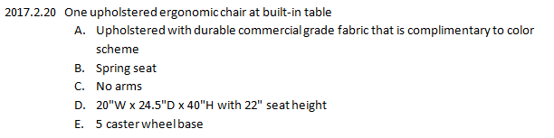
Brand Standards & Operating Manuals
Highlights Continued….
Section 2: FF&E Minimum Standards

Slide 17

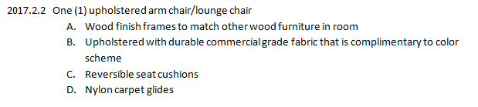

Brand Standards & Operating Manuals
Highlights Continued….
Section 2: FF&E Minimum Standards

Slide 18
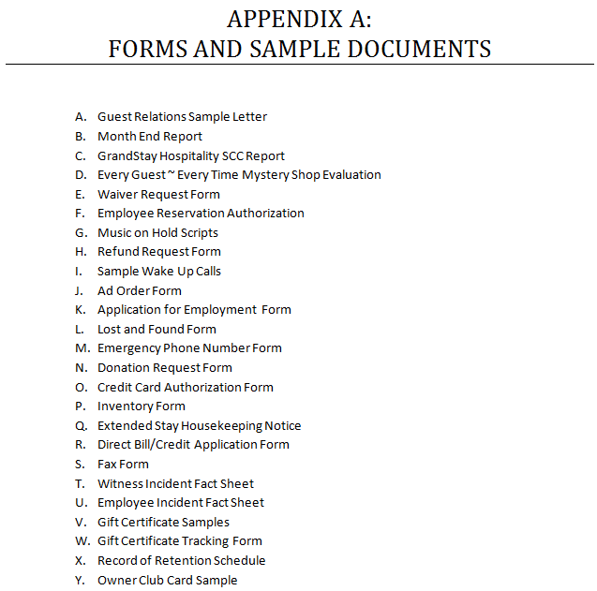
Brand Standards & Operating Manuals
Appendix A

Slide 19
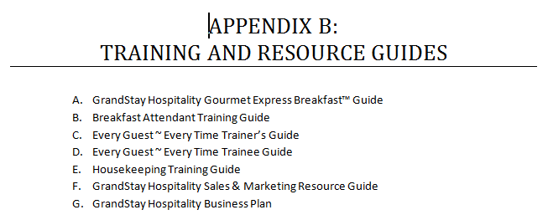
Brand Standards & Operating Manuals
Appendix B

Slide 20
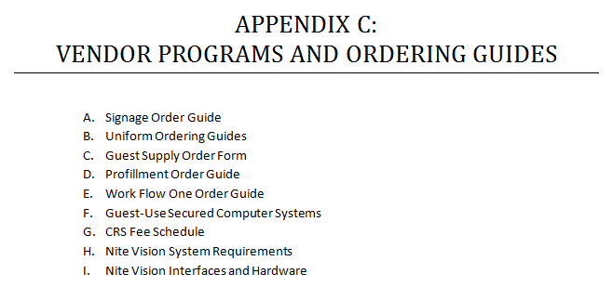
Brand Standards & Operating Manuals
Appendix C

Slide 21
GUEST SATISFACTION
Improving Guest Satisfaction Scores

Slide 22
GUEST SATISFACTION
THE MOST IMPORTANT TOOL FOR GUEST FEEDBACK!
GrandStay Hospitality Market Metrix Goals
Guest Satisfaction Index of 87.0 or higher
Guest Survey Monthly Submission Rate of 20%
Guest Issue Response Rate within 48 hours
2011 vs. 2012
Crossings: July YTD 87.1 vs. 89.4
GrandStay: July YTD 88.4 vs. 91.0

Slide 23
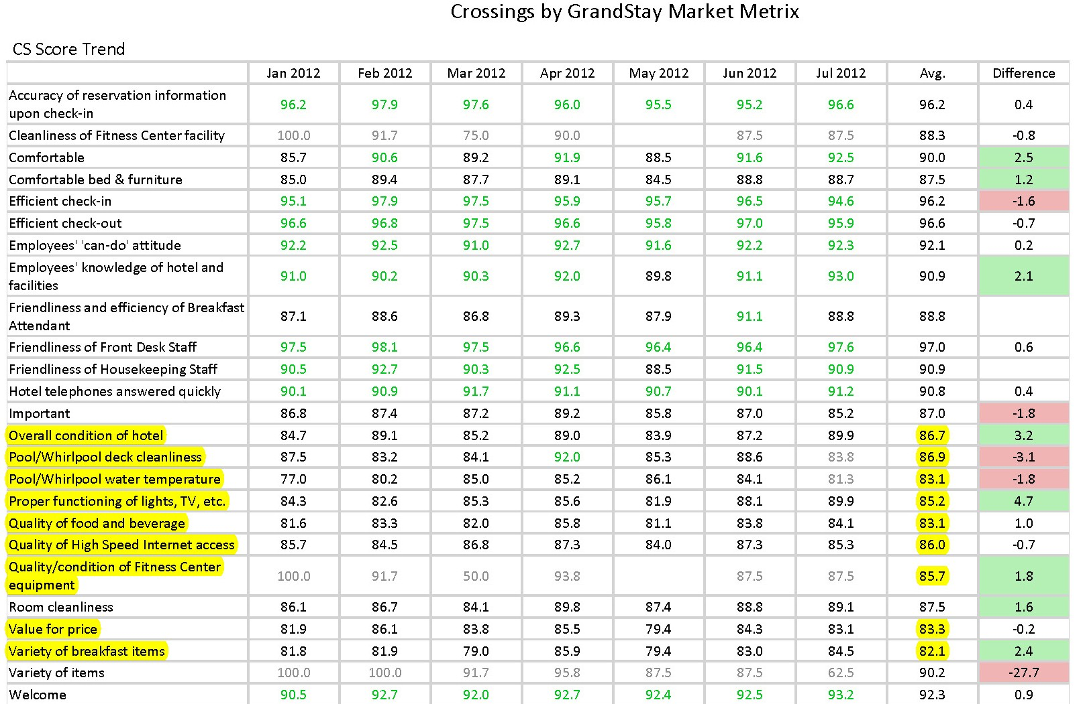
GUEST SATISFACTION

Slide 24
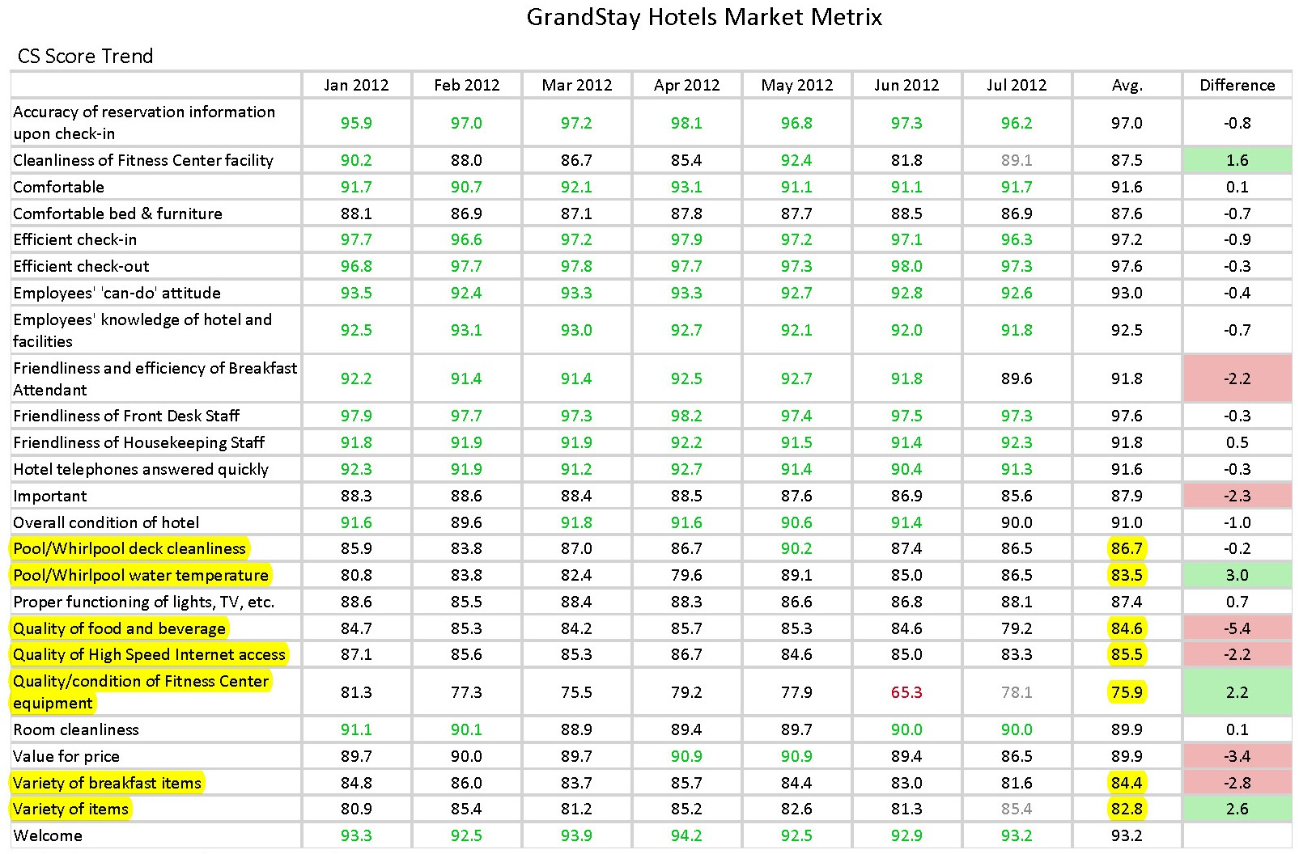
GUEST SATISFACTION

Slide 25
End of Month Reports
Beth Ramacher
Director of Accounting
GrandStay Hospitality, LLC

Slide 26
End of Month Reports
Changes Effective July 2012
2 items to email each month
    Completed End of Month Report (Spreadsheet)
    Occupancy Summary Report

Slide 27
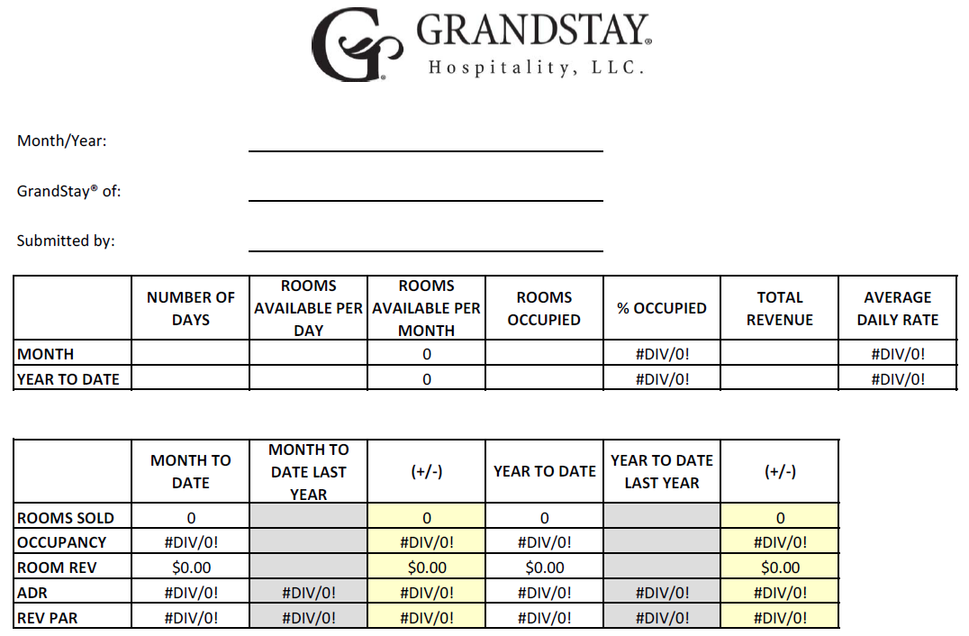
GrandStay End of Month

Slide 28
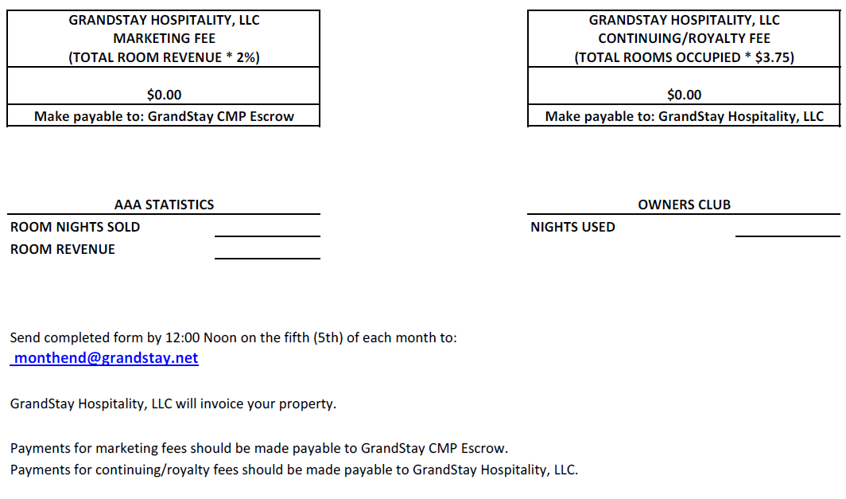
GrandStay End of Month

Slide 29
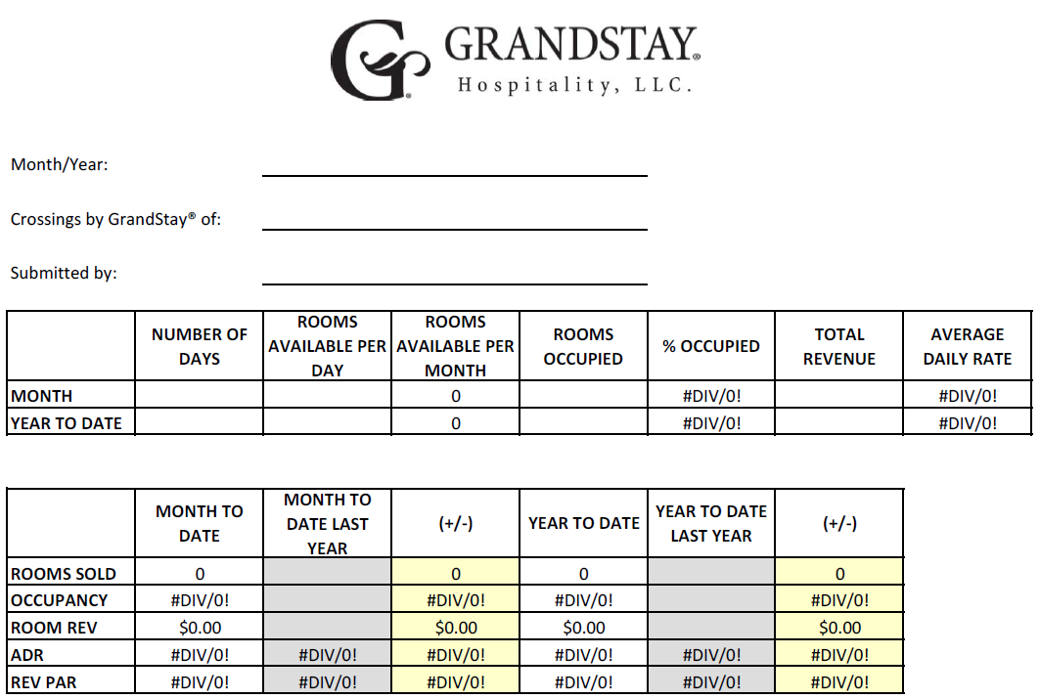
Crossings End of Month

Slide 30
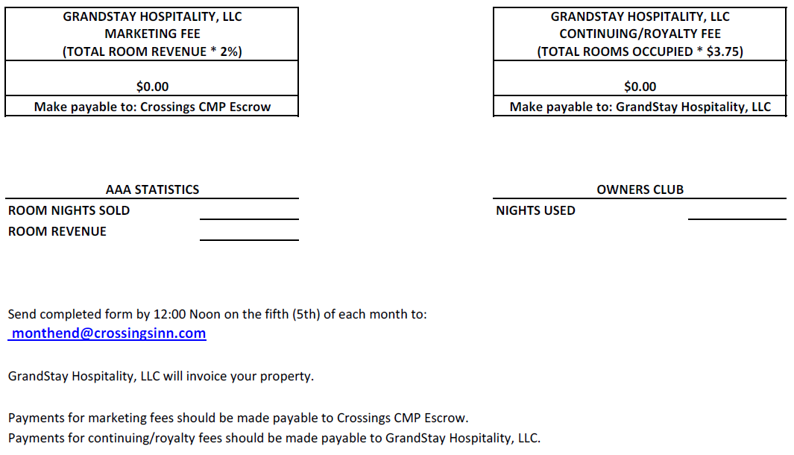
Crossings End of Month

Slide 31
End of Month Reports
Reports are due
    12:00 Noon
    Fifth (5th) of each month
Where to Submit
    Email to monthend@crossingsinn.com
    Email to monthend@grandstay.net

Slide 32
Average Operating Results
2011 Average Operating Results
Spreadsheet will be emailed to properties
    Email completed spreadsheet to
      bethr@grandstayhospitality.com
Statistics will be emailed to the field

Slide 33
Website, SEO, PPC & Social Media
Wendy Roe
Director of Sales & Marketing
GrandStay Hospitality, LLC
Peter Newhall
Head of Accounts
Adapta, Inc.
Mike Edens
Director of GID
EdensWorks, Inc.

Slide 34
Website
Adapta Interactive
adaptainc.com
Started work a month and a half ago
Full service web design and development services
Experience with hotel websites
Internal tracking system available 24/7
Located in Plymouth, MN

Slide 35
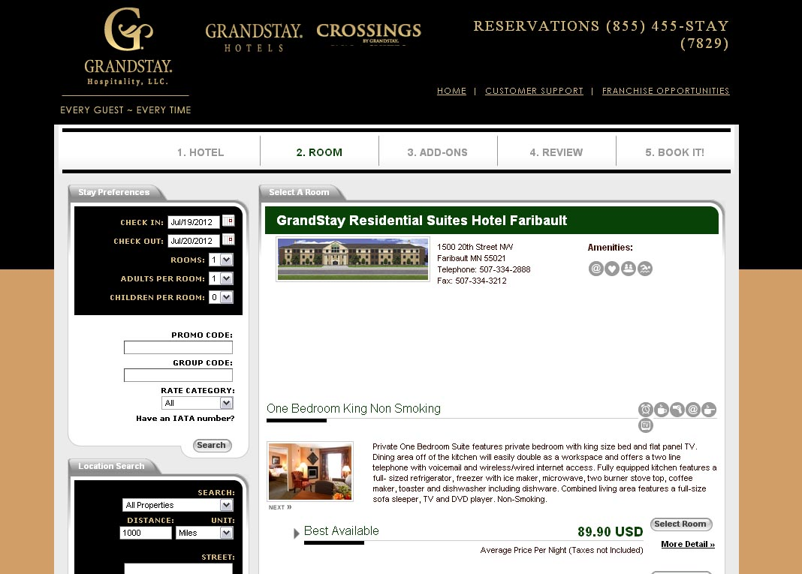
Website
Booking Engine Look

Slide 36
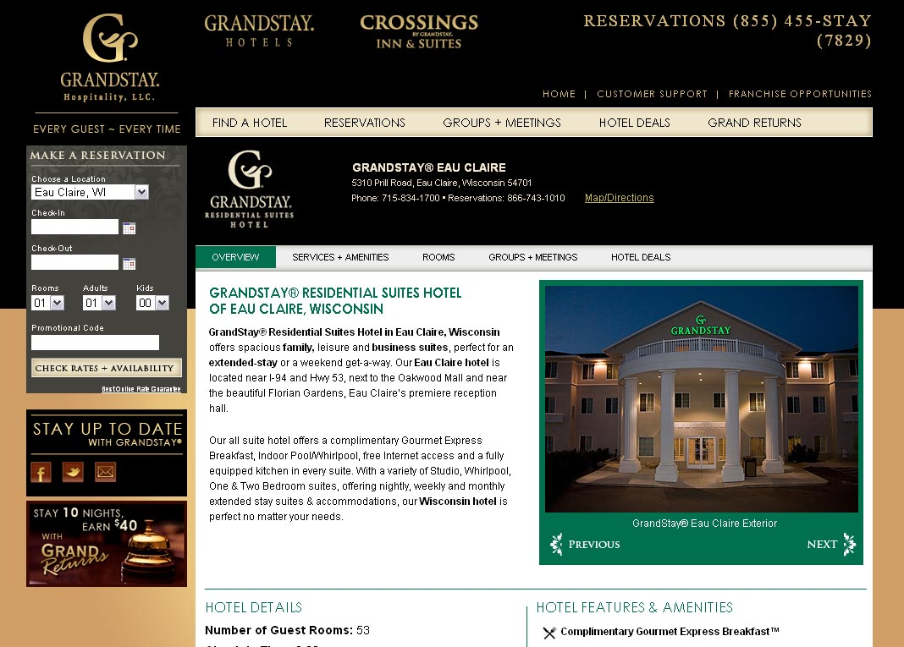
Website
Booking Engine Default Location

Slide 37
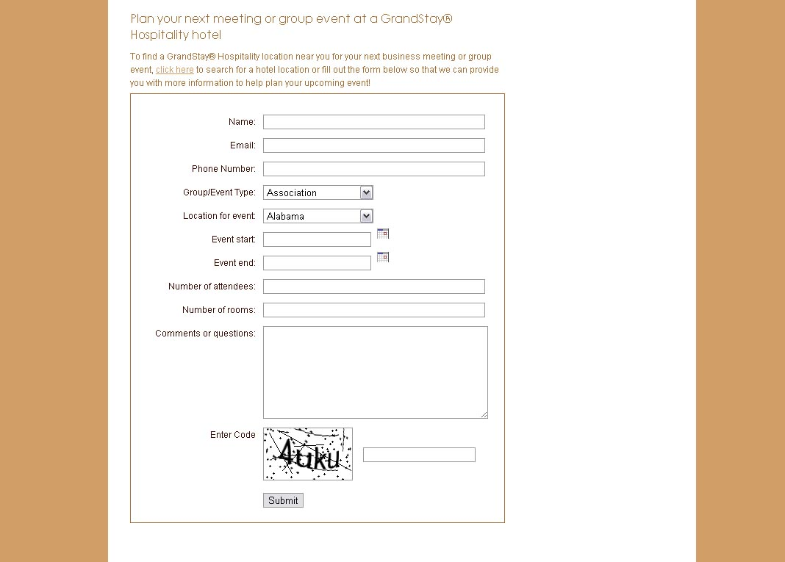
Website
Group/Events Form

Slide 38
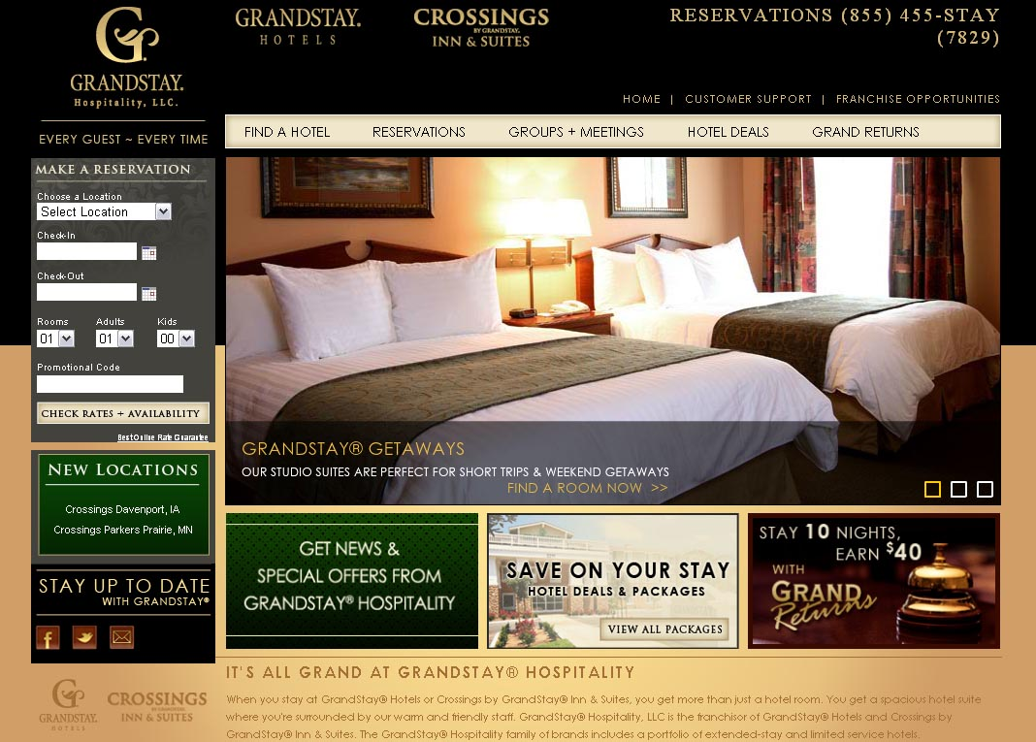
Website
Updated “New Locations”

Slide 39
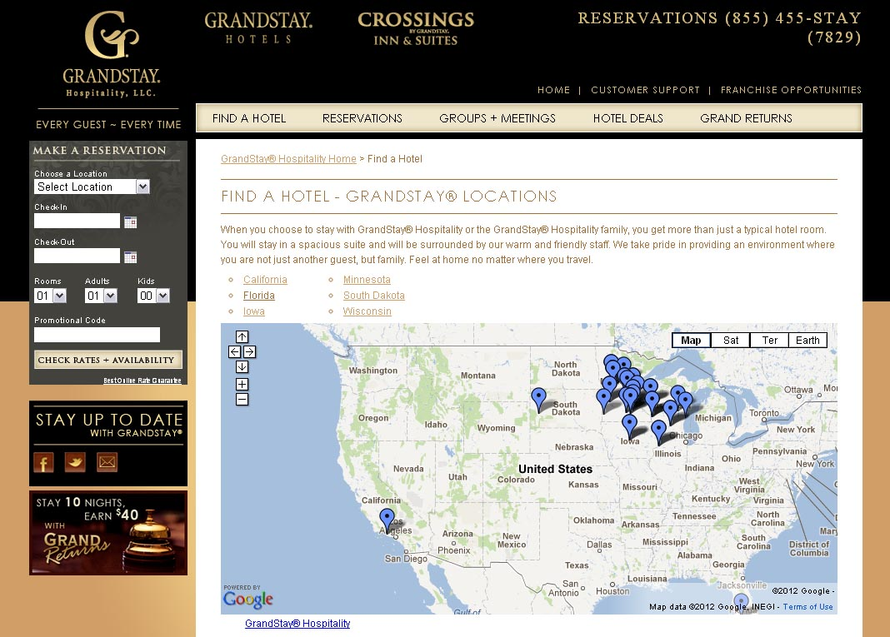
Website
Google Map of All Locations

Slide 40
Website
Hotel-Specific Website Improvements
Hardcoded Booking Engine to be location-specific
Added/removed 10 deal packages
Updated content for several locations
Added 2 new locations, removed 1 location

Slide 41
Website
Process For Ongoing Changes
Changes to Wendy by the 15th of every month
All changes can be set up and processed more efficiently
Long-Term Plan For Changes
Individual hotels to make direct changes with brand approval
Improved web presence for SEO and social media goals

Slide 42
Website
Photography Image Recommendations
Importance of professional photography
Send highest resolution of images to Wendy
Get permission in writing for photography for deal packages

Slide 43
SEO, PPC and Social Media
EdensWorks
edensworks.com
Search Engine Optimization
Pay Per Click Campaign Management
Social Media Marketing

Slide 44
SEO, PPC and Social Media
Online Marketing Update
Social media promotions/contests
PPC campaign management
Helping to optimize conversions
Help provide trackable results for marketing dollars spent

Slide 45
Q & A SESSION
The floor is now open for
Questions & Comments

Slide 46
NEXT WEBINAR
Mark your calendar…
The next GrandStay Hospitality, LLC
Quarterly Webinar will be held:
Wednesday, October 10, 2012, 10:00AM CST

Slide 47
THANK YOU
Thank You For Attending
GrandStay Hospitality Quarterly
Webinar Series

